Slide 1







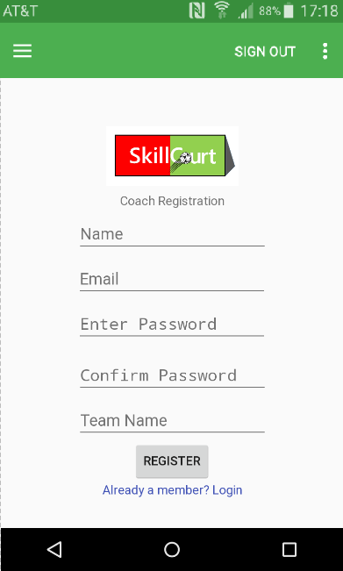
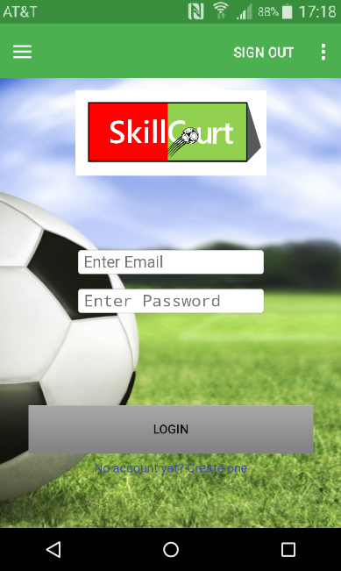
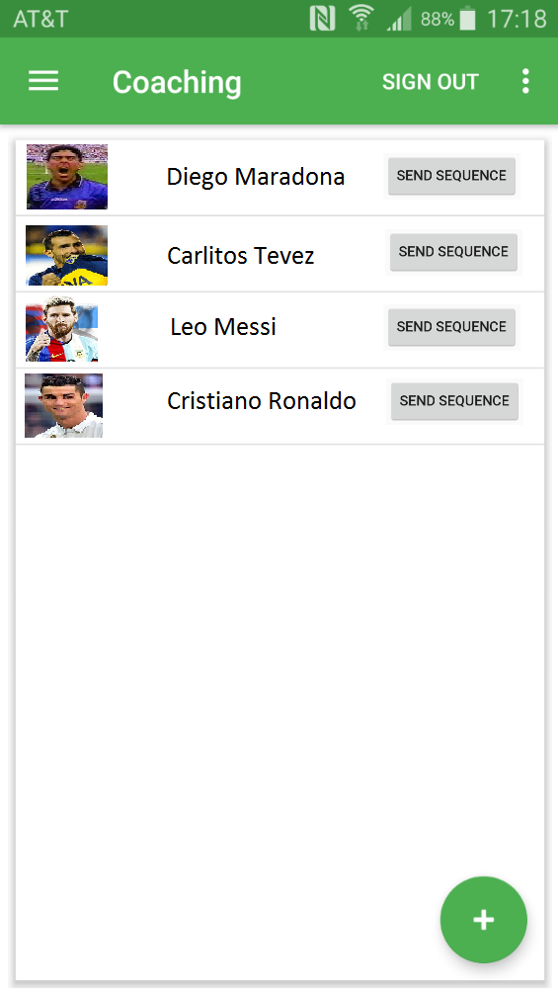
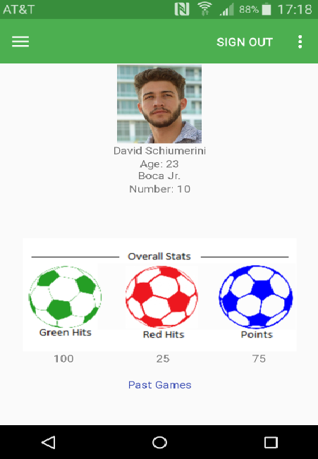
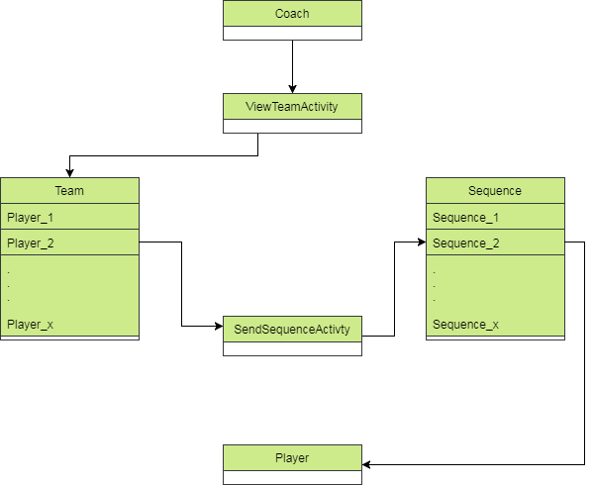
School of Computing & Information Sciences
Senior Project, 2017, Summer
SkillCourt v8.0
Student: David Schiumerini, Florida International University
Mentor: Guðmundur Traustason, Product Owner
Instructor: Masoud Sadjadi, Florida International University
Problem
Soccer is said to have been created mid-19th century and training methods have barely improved since then. Coaches would provide general drills for the whole team as one. This lacks the ability for a Coach to train individuals based on their strengths and weaknesses.
Solution
SkillCourt looks to enhance traditional training methods by supplying users the ability to record training procedure results in order to better plan for individual success. Creating a platform where a Coach level user can review Player scores and designate specific game sequences can accomplish this.
Current System
Previously there was only a single level (general) account. It was not possible to share or request to view ones match history. There was no ability to manage Players or share training sequences.
Screenshots
Requirements
Guest must be able to register as Player or Coach
Coach has ability to manage a team of Players that are able to see their match histories and send game sequences to them.
Coaches can register accounts for Players.
Players can accept or decline team invitations.
Any user can create and save a game sequence.
System Design
SkillCourt uses Java which was developed with the Android Studio’s development environment. The Android App. connects directly to Arduino pads which receive instructions on how to light up and send on hit notifications back to the Android App. These “hits” are registered by the app and data on recorded during the games are saved to Firebase in real time.
Implementation
Upon successful login pull Coach’s profile from Firebase.
Coach acknowledges desire to view team; Coach’s team ID is sent to Firebase and retries all Players registered.
Once player then sequence desired is selected; system fetches sequence from Firebase and stores into players personal account.
Verification
For verification, integration testing via black box testing techniques was used. With these tests one could verify that the proper user information would be displayed upon addition, deletion, or edits of the users information within the Firebase database. Tests were implemented to ensure information was valid.
Object Design
Summary
SkillCourt provides an innovative way for Individual players to train and hone their soccer skills, with the help of coaches. Coaches are provided a platform to better organize their team of players, by designing personal training procedures with match statistics provided by SkillCourt to help players achieve their goals.
Acknowledgement
The material presented in this poster is based upon the work supported by Felix Garcia and Michael Thompson. I am thankful to the help that I received from my group member Richard Rodriguez.
Notes:
1

